Slide 2
Mastering D365 Implementations with Azure synergy - Empowering the Future of Solution Architects v3.0
NEILL RIORDAN
COE lead D365 F&O
KPMG UK
JOSE AZEVEDO
COE lead D365 BC
KPMG UK

Slide 3
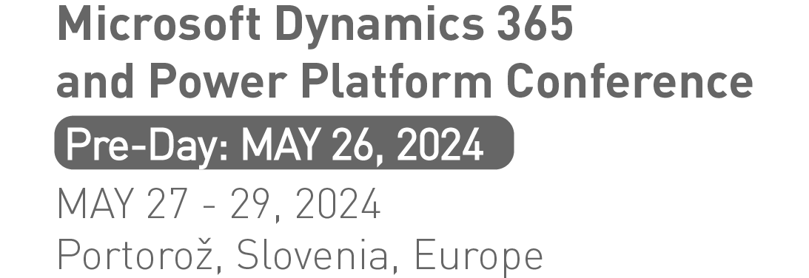
Agenda
Pop-Up Quiz
Solution Architecture – The Role & the challenge
Holistic View
Key Take Aways
Q & A

Slide 4


DynamicsMinds - Slovenia - May 2024
ⓘ Start presenting to display the poll results on this slide.

Slide 5
Solution Architecture
Definition

Slide 6
Solution Architecture Definition
“The solution owner of all Microsoft products in the project”
MS Fast Track
“a description of a discrete and focused business operation or activity and how IS/IT supports that operation”
Wikipedia
“refers to the process of designing and defining the structure of a system that solves specific business problems”
OpenAI

Slide 7

Solution Architecture – The Role & the challenge
PM
TA
3-Way Tension
SA
Time and Quality
Scope and Solution
Approach and Mindset

Slide 8
Holistic View

Slide 9


Holistic View
The Wheel
Recent Years
Ready for the future

Slide 10
Solution Architecture – Holistic View
Industry
Technical
Fast-Track knowledge of our chosen industries
Retail, Local Gov’t, FS
Azure components
Core application competence
Fit/Gap across the technologies (e.g.)SA from CE
Engagement & Team Skills
Functional
Leadership and Motivation skills
Collaboration
Presentation
Solution Architecture
Business awareness (e.g.) Org structures, finance (e.g.) Basic concepts
Common business terminology (e.g.) DOA
Problem Solving
Method
Solving strategies
Problem solving tools & techniques
Method and approach
Tooling
Estimating
Stakeholder Management
Commercial
Trusted Advisor
C-Suite language and messages
Negotiation
Commercial awareness
Management of programme cost and change
Solution value

Slide 11
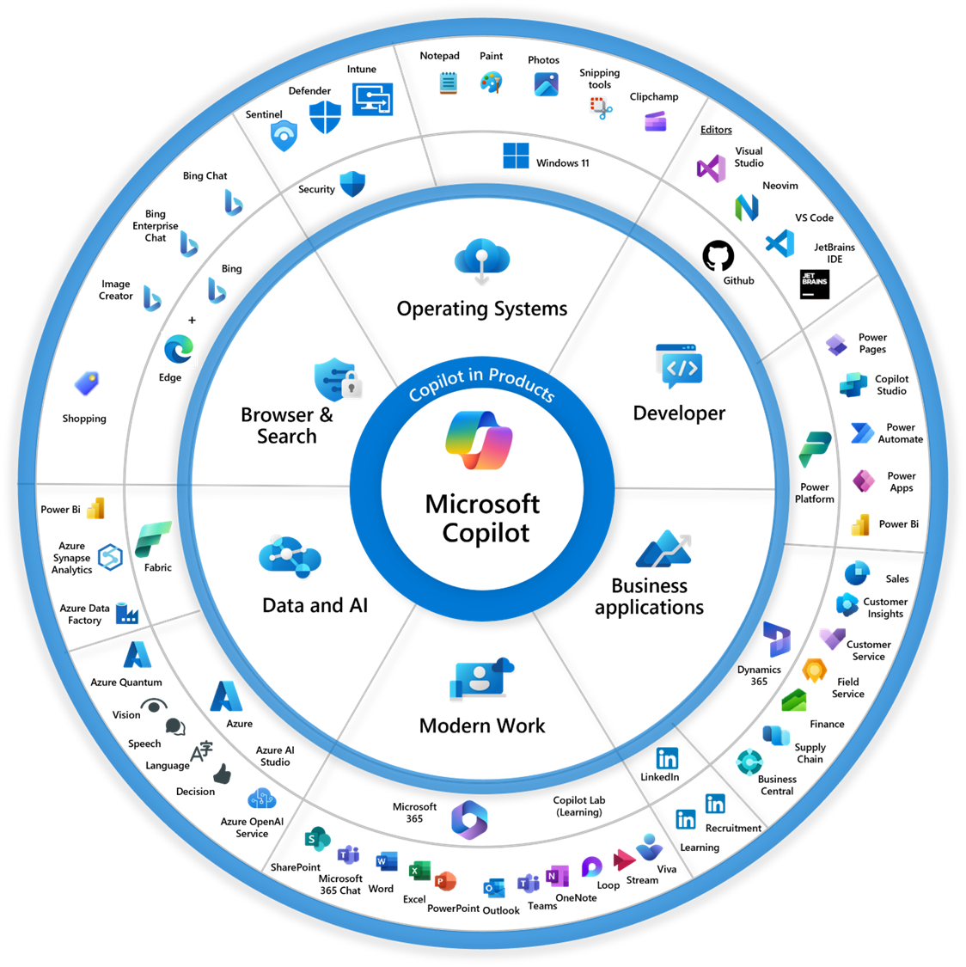
Technical
Azure components
Core application competence
Fit/Gap across the technologies (e.g.)SA from CE
Functional
Business awareness (e.g.) Org structures, finance (e.g.) Basic concepts
Common business terminology (e.g.) DOA

Slide 12
Journey

Slide 13
Core Components
Integration Layer
Dynamics 365
BI and Analytics

Slide 14
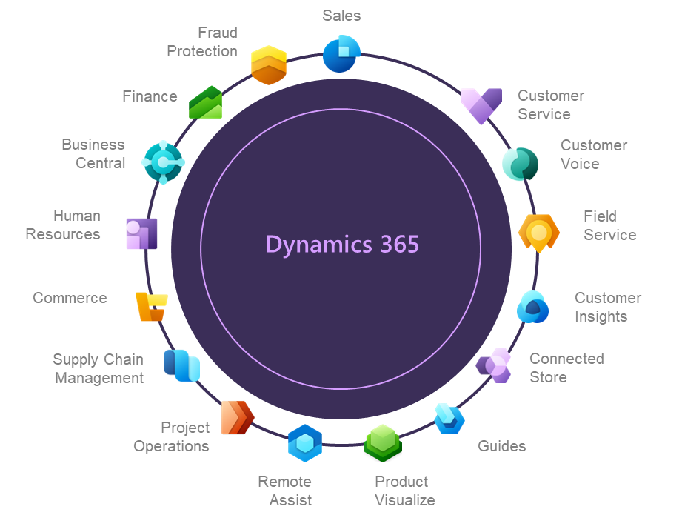
The Scope of Dynamics 365
Integration Layer
BI and Analytics

Slide 15
Integrations are the Star
Global Integration Layer
Local Integration Layer
Local Integration Layer
Local Integration Layer
Local Integration Layer
BI and Analytics

Slide 16
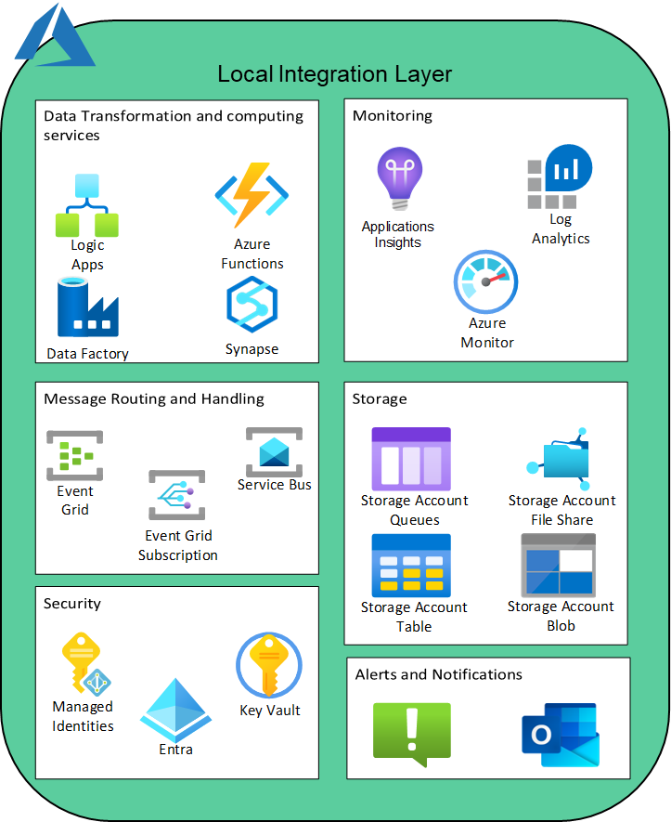
Global Integration Layer

Slide 17
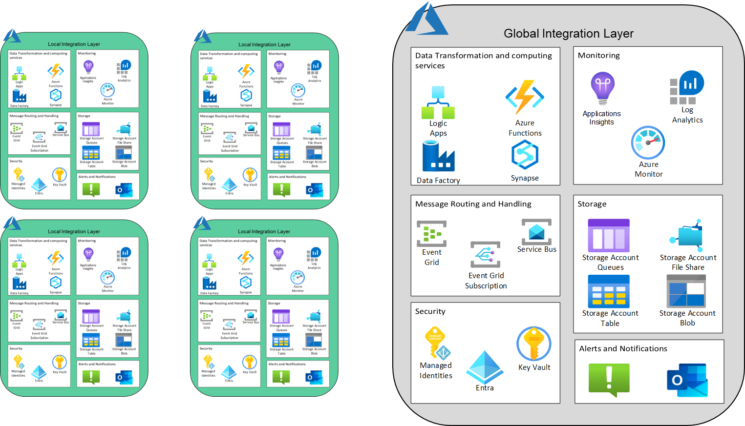
On to the Data
BI and Analytics

Slide 18
Its not just one data platform
Workload BI and Analytics
ESG One Lake
BI and Analytics
Workload BI and Analytics
Workload BI and Analytics
Workload BI and Analytics

Slide 19
OneLake
Dataverse

Slide 20
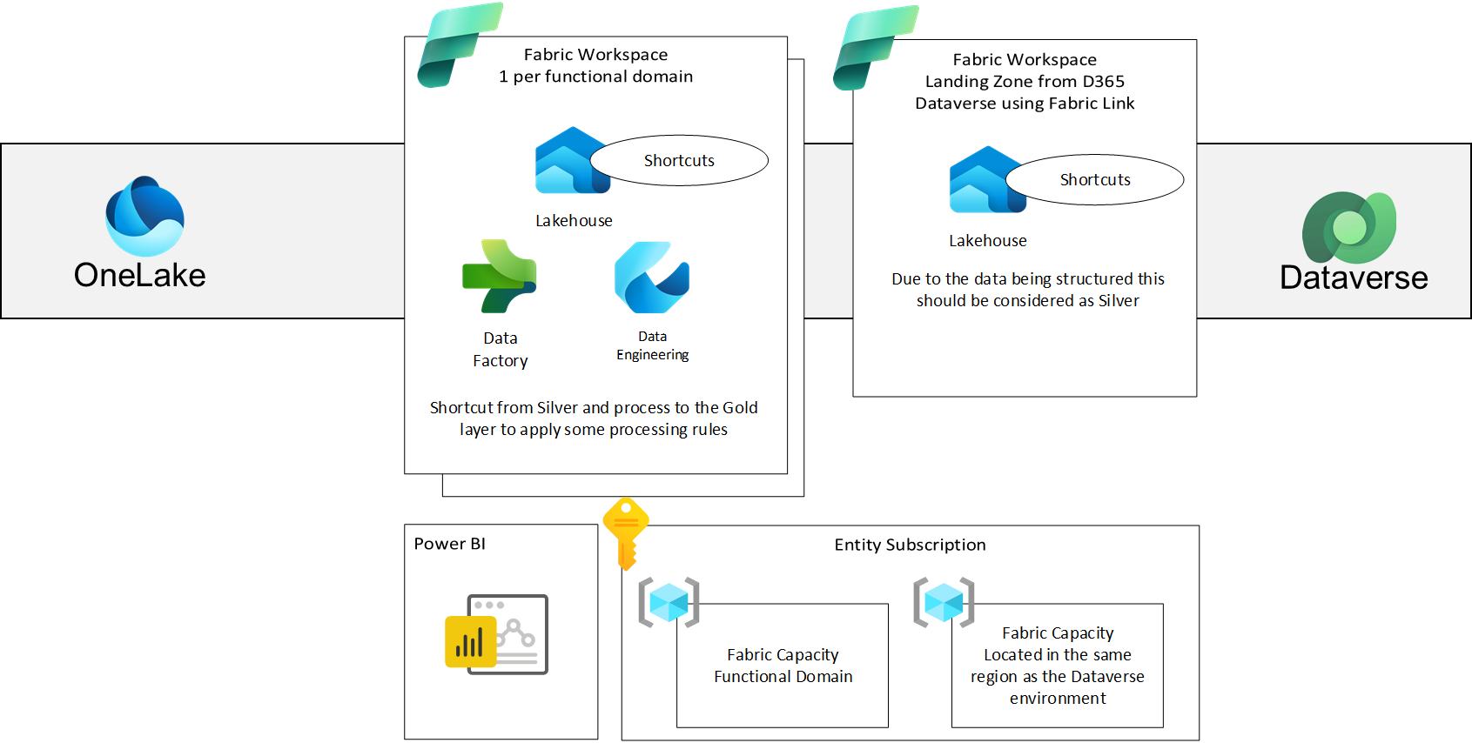
The Solutions Continues to Grow

Slide 21
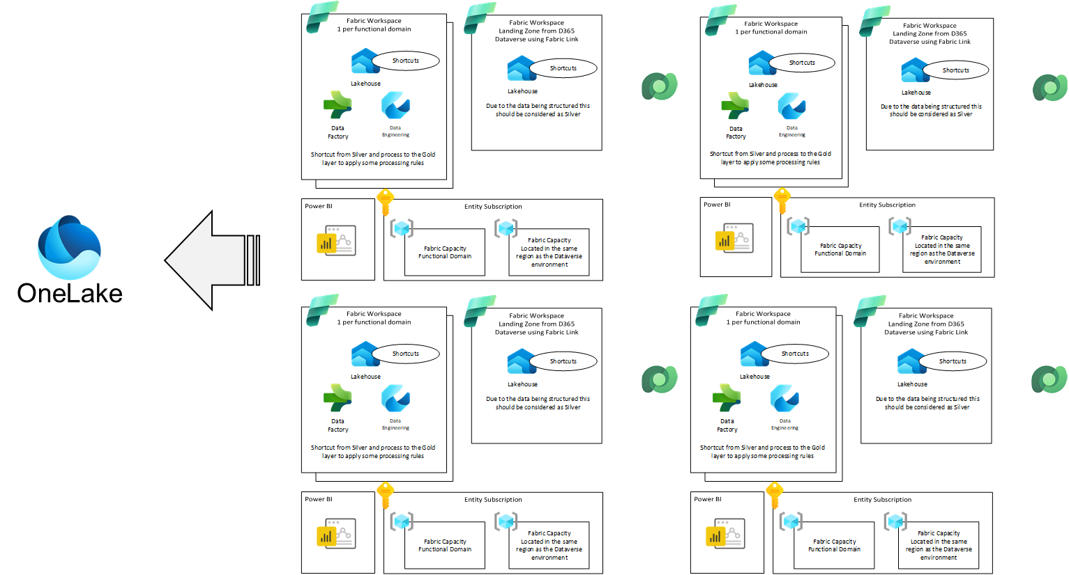
The Multi Instance Multiplier

Slide 22
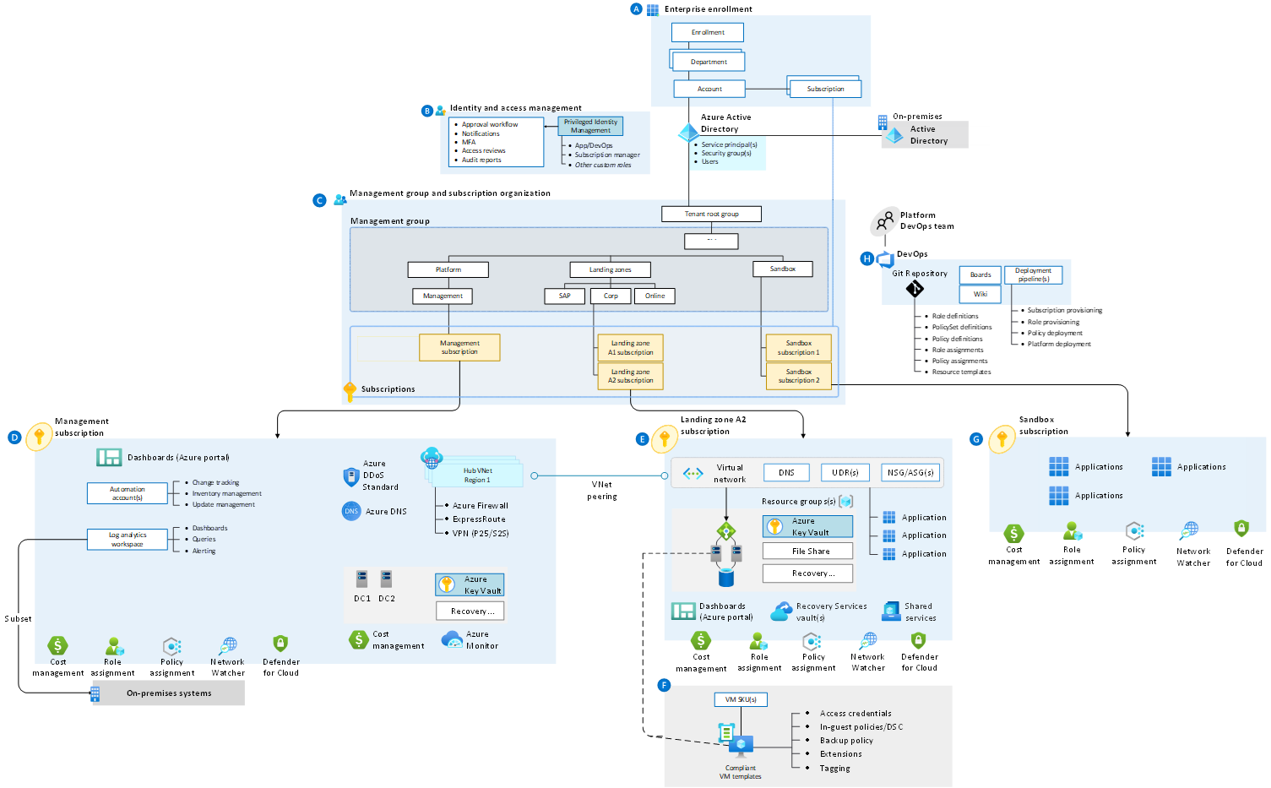
Landing Zones the True Starting Point

Slide 23
Key Take Aways

Slide 24
Key Take Aways
Individual Survey – Holistic View - The wheel
Push to be in the Governance conversations and meetings
Identify role models and mentors
Setup an Architecture Academy
Full cycle with Senior SAs
Promote Senior SAs to Coaches AA
Practice organised by needs and not products (ERP Practice)
Allow organic growth from resource pool
Turn this approach as a living approach

Slide 25

Q & A
Photo above can be deleted and replaced.

Slide 26
Thank you for your attention!
Neill Riordan
neill.riordan@kpmg.co.uk
https://www.linkedin.com/in/neillriordan/
José Azevedo
maique00@gmail.com
https://www.linkedin.com/in/josemiguelazevedo/

Slide 27








KEY DESIGN ELEMENTS

Slide 28
OneLake

